Slide 1
PMPRB Update
Pharma Symposium Canada
March 31, 2015

Slide 2
Canadian pricing and reimbursement regime
Canada is the only developed country in the world with a universal public health insurance program that excludes coverage for prescription drugs.
As such, Canada is fairly unique in that it does not have a national pharmaceutical negotiator and formulary for its population.
Federally, the PMPRB reviews patented drugs and sets price ceilings based on level of therapeutic improvement, domestic prices and prices in the “PMPRB7”.*
At the provincial level, CADTH reviews drugs for therapeutic benefit and cost effectiveness and makes reimbursement recommendations to participating public payers.

Slide 3
Pricing and reimbursement (continued)
Provincial and territorial health ministries negotiate prices directly with manufacturers, either individually or under the auspices of the pCPA.
Private insurers manage employer-sponsored drug plans and also negotiate prices with manufacturers, but wield less purchasing power than provinces.
Uninsured Canadians (mainly the working poor) pay for prescription drugs at “list” prices.
One in ten Canadians said to be unable to afford to fill their prescriptions (CMAJ 2012).
Payer | Share of drug costs
Public insurance | 42%
Private insurance | 35%
Out-of-pocket (uninsured) | 23%

Slide 4
Pharmaceutical Regulation in Canada is Shared
PMPRB
Jurisdiction covers patented drug products sold in Canada, whether through market approval or under Health Canada’s Special Access Program (SAP)
Over Life of Patent(s)
Health Canada
Review For Safety, Efficacy & Quality
Health Canada
Post-Market Surveillance
Market Approval
Private Drug Plan Reimbursement
Public Drug Plan Reimbursement
CADTH Common Drug Review
Individual Federal/Provincial Public Drug Plan Listing

Slide 5
Drug share of total health spending (2012)
Drugs are the second/third (depending on year) largest health cost for Canada, but they are by far the largest health cost for uninsured Canadians .

Slide 6
PMPRB 101
The PMPRB is an independent, quasi-judicial consumer protection agency with a regulatory and reporting mandate.
We are 60 civil servants on “staff” and 5 Cabinet-appointed Board members.
On the regulatory side, staff review patented drug prices to ensure they are not excessive as per the Patent Act and corresponding Regulations and Guidelines.
Where staff considers the price of a drug to be excessive, a patentee can agree to pay back excess revenues and/or lower its price through a voluntary settlement (VCU).
If the patentee refuses a VCU, a hearing will be held before a panel of Board members if the Chairperson considers it in the public interest.
If the panel decides a drug is excessively priced, it can order the patentee to reduce its price and/or pay back excess revenues.

Slide 7
Regulatory mandate
At intro, a drug’s price ceiling is set based on its category of therapeutic improvement, the price of domestic comparators and its price elsewhere in the PMPRB7.*
Four therapeutic categories, with descending price ceilings (in theory):
  Breakthrough
  Substantial Improvement
  Moderate Improvement
  Slight/No Improvement
After introduction, an existing drug is eligible for CPI-based price increases.
At no time can a drug’s price exceed the highest in the PMPRB7 (HIPC rule).
* France, Germany, Italy, Sweden, Switzerland, the UK and the US.

Slide 8
Reporting mandate
Annual Report
Analysis of prices of patented drugs, price trends of all drugs, and R&D spending: http://www.pmprb-cepmb.gc.ca/en/reporting/annual-reports
National Prescription Drug Utilization Information System (NPDUIS)
Established in 2001 as an F/P/T research initiative to provide policy makers and drug plan managers with analyses of price, utilization and cost trends
The NPDUIS Advisory Committee advises the PMPRB and provides expert oversight and guidance for the analytical reporting of the initiative
The Committee is composed of BC, AB, SK, MB, ON, NB, NS, PEI, NL, YK, NIHB & HC, CIHI and CADTH.

Slide 9
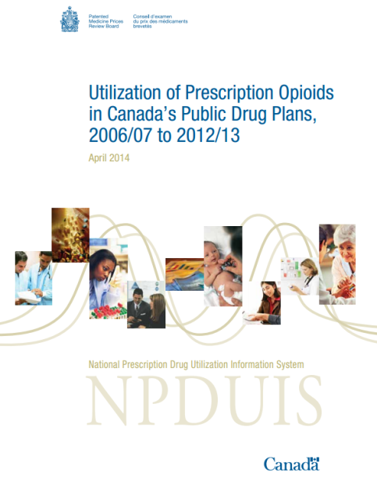
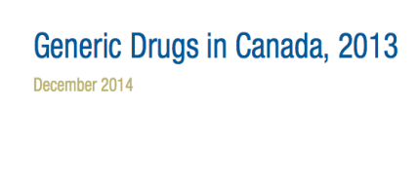
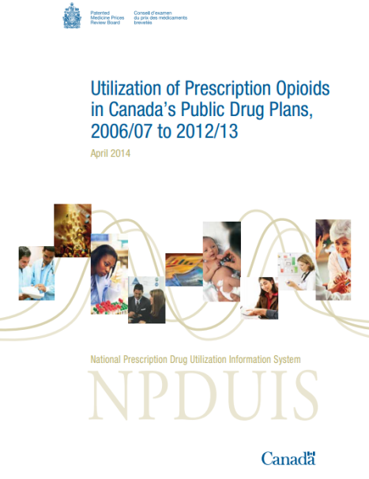
NPDUIS
Reports published in 2014/15
CompassRx, 2012-13
Generic Drugs in Canada, 2013 – December 11, 2014
New Drug Pipeline Monitor, 6th edition – December 2013
Utilization of Prescription Opioids in Canada's
Public Drug Plans, 2006/07 to 2012/13 – April 2014
Research agenda
Private Drug Plans in Canada: Generic Drug Market, 2013
International Retail Price Comparison, 2013
Compass Rx, 2013-14
Private Drug Plans in Canada: Cost Driver Analysis, 2013
Utilization and Cost of Biologics, 2005/06 to 2012/13
Private Drug Plans in Canada: High-Cost Drugs, 2013
New Drug Launch Monitor, 2014
New Drug Pipeline Monitor, 7th edition

Slide 10
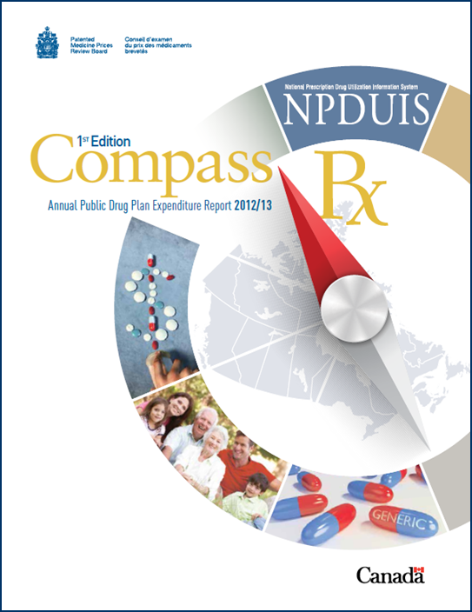
New NPDUIS flagship report
Comprehensive analysis of cost
drivers in public drug plans:
Price effects
Demographic effects
Volume effects
Drug-mix effects
Release date is today!
http://www.pmprb-cepmb.gc.ca/

Slide 11
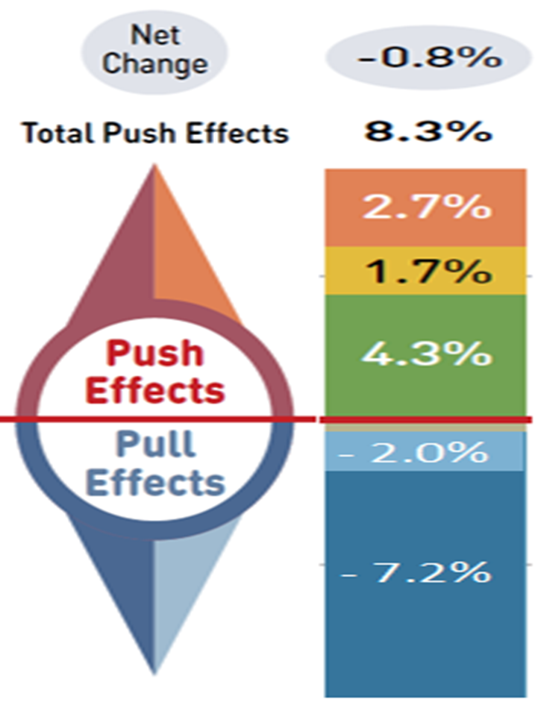
Compass Rx – “push-pull” drug spending effect
Total Push Effects 8.5%
Although net growth in drug spending has been low in recent years because of the “pull effect” of increased generic substitution and generic price reductions, that phenomenon appears to have run its course.
In the coming years, the cost drivers behind the “push effect” are expected to pose a challenge to the sustainability of both public and private drug plans, for example, in 2014:
  Spending on high cost biologics grew by 10.4%;
  Spending on high cost oncology drugs grew by 12.3%.
Demographic
Volume
Drug-Mix
Price change
Generic Subs
Total Pull Effects -9.2%

Slide 12
Has Canada already turned the corner?
Source: IMS Brogan. Canadian Drug Stores and Hospitals Purchases, MAT December 2014

Slide 13
Latest data on drug-mix effect
Source: IMS Brogan. Canadian Drug Stores and Hospitals Purchases, MAT December 2014

Slide 14
Canada’s performance is not strong within PMPRB7…
Source: IMS MIDAS, 2013

Slide 15
… nor within the OECD
OECD Average: $498
Source: OECD, 2012

Slide 16
… and price is clearly a contributing factor

Slide 17
Why are prices going down in other countries?
Over the 2010-2012 period, 23 European countries began planning or executed a major reform of their pharmaceutical price regulatory framework.
Country | Year | Type of Reform
UK | 2014 | Annual, per company, public expenditure ceilings – 0% growth for next two years.
Sweden | 2014 | 7.5% price reduction for drugs >15 years old not subject to generic competition.
Switz | 2013 | Legislated negotiated price reduction of 2500 drugs.
Italy | 2013 | Expenditure ceiling, performance based reimbursement, 2-year price re-evaluation.
France | 2012 | Mandatory price review every 5 years, reimbursement rates cut for low innovation medicines, new stringent therapeutic evaluations.
Germany | 2011 | Consolidation of regulatory roles, mandatory rebates to public plans.

Slide 18
Germany: impact of AMNOG
Canada
2011 “AMNOG” reform is expected to save €2 billion per year and has already reduced the price of the 25 top-selling brand drugs by an average of 23%.

Slide 19
As prices go up, R&D is going down

Slide 20
Why is this happening?
R&D
Evidence does not support purported link between price, IP and R&D.
Other factors, such as head office location, science base, clinical trial infrastructure, population density, etc. appear to be better predictors of locus of pharmaceutical R&D
Price
As noted, EU countries are taking aggressive action to control drug costs.
No national purchasing authority in Canada, and key decisions impacting price are made independently of one another by different F/P/T players.
PMPRB regime not keeping up with international or industrial trends.

Slide 21
Payers are concerned about sustainability
  “The (provincial drug plan) programs are starting to face extreme financial constraints. The growth that we’re seeing in some categories of drugs is far beyond what were ever anticipated four or five years ago.”
      Fred Horne, Alberta Minister of Health, speaking at April 7, 2014 CADTH symposium
  “We’re now at a point where ongoing sustainability of meaningful prescription drug coverage is threatened for a vast number of Canadians. In the past few years alone, the number of very-high-cost medications for genetic disorders, cancer and auto-immune diseases has increased substantially -- and this trend is expected to continue.
      Frank Swedlove, President of CLHIA, speaking at the October 30, 2013 Conference Board 2nd Summit on Sustainable Health Care

Slide 22
What’s next for the PMPRB?
In 1987, Canada signalled its willingness to pay its “fair share” of international drug development costs with enactment of present day drug patent policy – Bill C-22.
Bill C-22 also created PMPRB as consumer protection “pillar” of that policy.
PMPRB7 selected on basis of assumption that by offering comparable “fair” prices and patent rights, Canada would come to “emulate” R&D levels in these countries.
With Canadian prices approaching second highest of PMPRB7 and R&D at record lows, that assumption now being questioned, as is relevance of PMPRB.
Timing opportune for fresh look at PMPRB framework in light of current CETA changes, sustainability concerns and GoC priorities (eg. price gap, defending consumers).
PMPRB to publish new three year strategic plan in spring 2015 – stay tuned…

Slide 23
Thank you.
Merci.
www.pmprb-cepmb.gc.ca
Twitter: @PMPRB_CEPMB
23

