Slide 1
Patented Medicine Prices Review Board
Filing Requirements
PMPRB 101
Ottawa, December 6, 2012

Slide 2
Brief Overview of the Filing Session
The different forms that need to be filed
Section 82: Notification of Intent to Sell
Form 1
Form 2
Filing timelines
Reporting process

Slide 3
Brief Overview of the Filing Session
Failure to File
Common filing errors
Compliance Status Reports
Where to find the forms on the PMPRB website

Slide 4
What needs to be filed?
Section 82 Notification of Intent to Sell a Patented Medicine
82(1) A patentee of an invention pertaining to a medicine who intends to sell the medicine in a market in Canada in which it has not previously been sold shall, as soon as practicable after determining the date on which the medicine will be first offered for sale in that market, notify the Board of its intention and of that date.
FORM 1 Medicine Identification Sheet
FORM 2 Information on the Identity and Prices of a Medicine
Must be submitted in Excel format.
All filings to be sent to compliance@pmprb-cepmb.gc.ca

Slide 5
Filing Schedule
FORM 1 Medicine Identification Sheet (electronic Excel format including Product Monograph)
Information | Timing | Patent Act | Regs
Identity of the drug product, patentee and patent(s) | Earliest of: Seven (7) days after the date of the first NOC issued Seven (7) days after date of first sale in Canada | 80(1)(a) 80(2)a) | 3(1) 3(2) 3(3)
Updating information on identity of the drug product/patentee | Within thirty (30) days after any modification of information |  | 3(4)

Slide 6
Filing Schedule cont’d
FORM 2 Information on the Identity and Prices of the Medicine (electronic Excel format)
Information | Timing | Patent Act | Regs
- Price & sales data for the drug product sold to each class of customer (H, P, W, O) by province/territory in Canada - Publicly available ex-factory price sold to each class of customer in Canada and 7 countries listed in Regulations | - When a drug product is first offered for sale in Canada, no later than thirty (30) days after the first day of sales Each year: On or before July 30 (Jan. 1 to June 30 reporting period) On or before Jan. 30 (July 1 to Dec. 31 reporting period) | 80(1)(b) 80(2)(b) | 4(1)(e) 4(2) &(3) 4(1)(f)

Slide 7
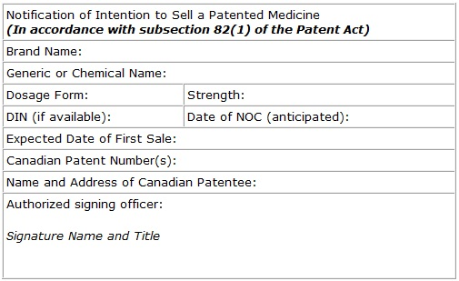
Notification of Intent to Sell
All filings to be sent to compliance@pmprb-cepmb.gc.ca
Notes:
-Date does not have to be specific

Slide 8
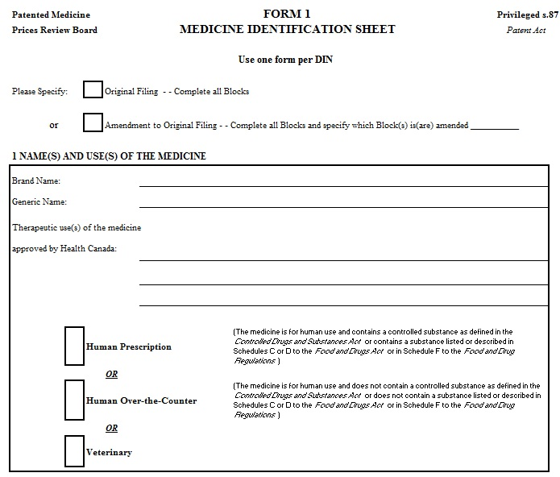
Form 1 – Block 1

Slide 9
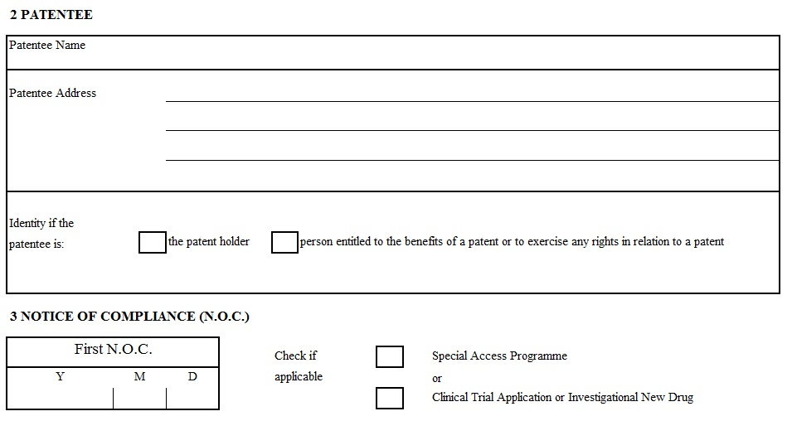
Form 1 – Blocks 2 & 3

Slide 10
Form 1 – Blocks 4, 5 & 6

Slide 11
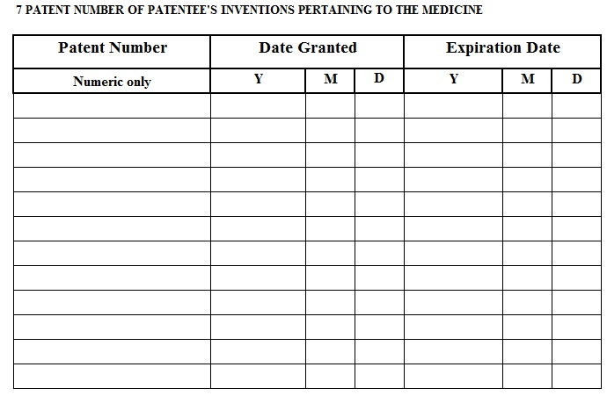
Form 1 – Block 7

Slide 12
Patent (Patent Act Section 45)
If application filed on or after October 1, 1989
Duration = 20 years after filing date
If application filed before October 1, 1989
Duration = 17 years from date on which patent was issued
When patent is reissued, no change in length of patent
Ex. Patent filed in 1994, issued in 1998, reissued in 2002, will expire in 2014 (20 years after initial filing)
Laid open starts at the publication date
http://www.cipo.ic.gc.ca/eic/site/cipointernet-internetopic.nsf/eng/Home?OpenDocument
Exercise: patent CA 2408697

Slide 13
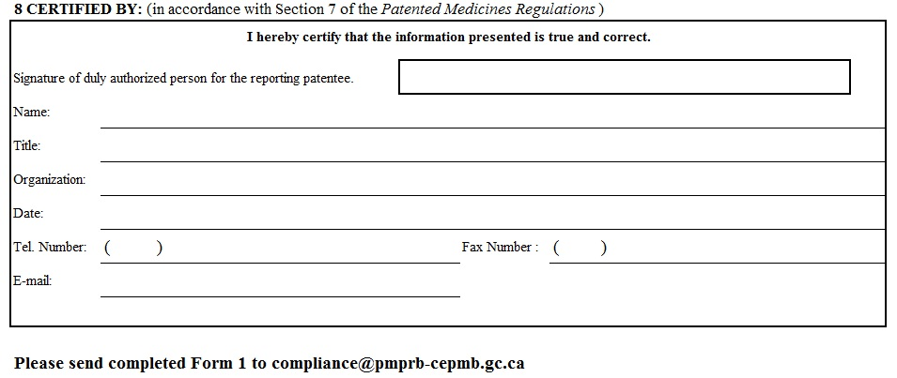
Form 1 – Block 8

Slide 14
Form 2 – Identity and Prices of the Medicines
Includes information on the medicine and patentee
Price and sales information within Canada and publicly available ex-factory international prices
The first day of sales of a drug product must be filed no later than 30 days after the date of first sale.
Semi-annual filing for all patented medicines sold in Canada by patentee must be filed 30 days after the end of the reporting periods
i.e. January to June period to be filed July 30; and July to December period to be filed before January 30.
All files to be submitted in Excel format.
Notes:
Ask Beatrice about mentioning that the filing times may change

Slide 15
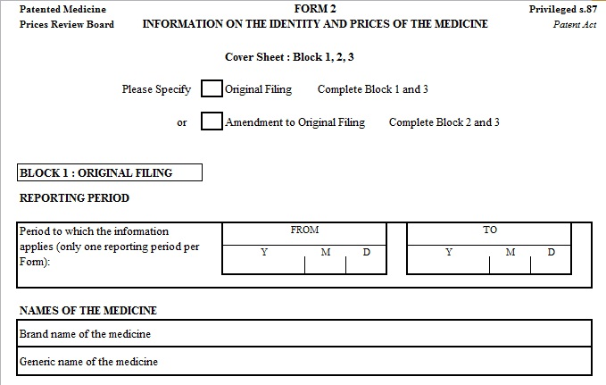
Form 2 – Block 1

Slide 16
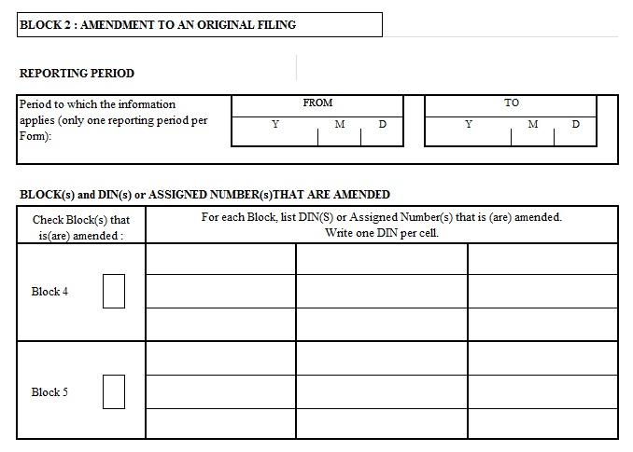
Form 2 – Block 2

Slide 17
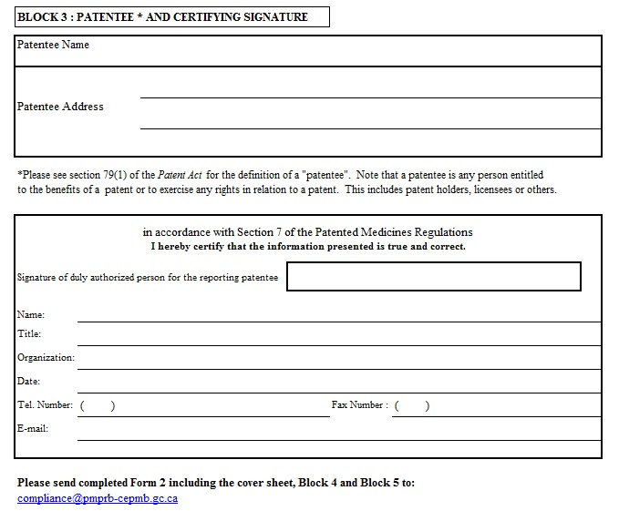
Form 2 – Block 3 and Signature

Slide 18
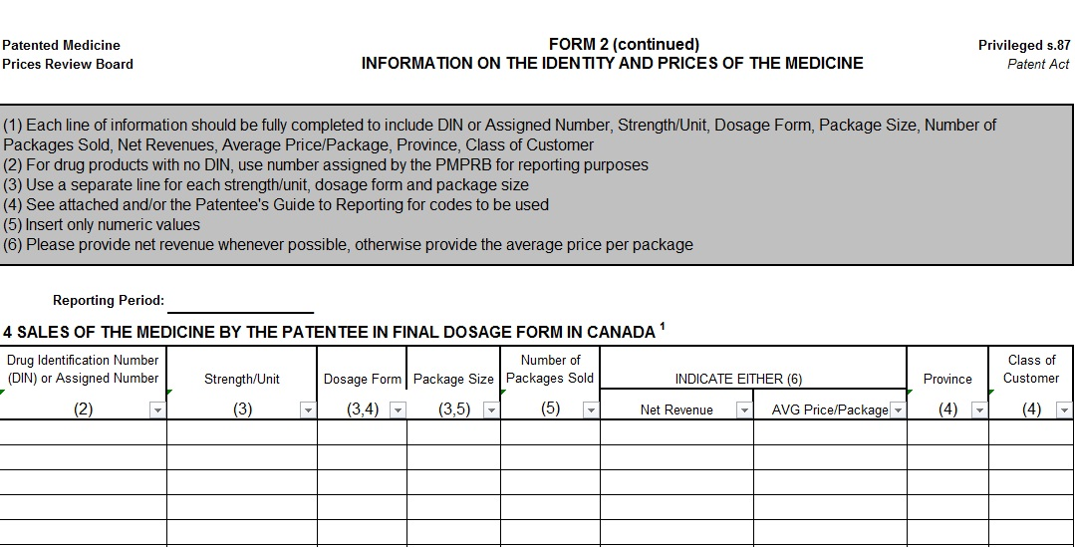
Form 2 – Block 4

Slide 19
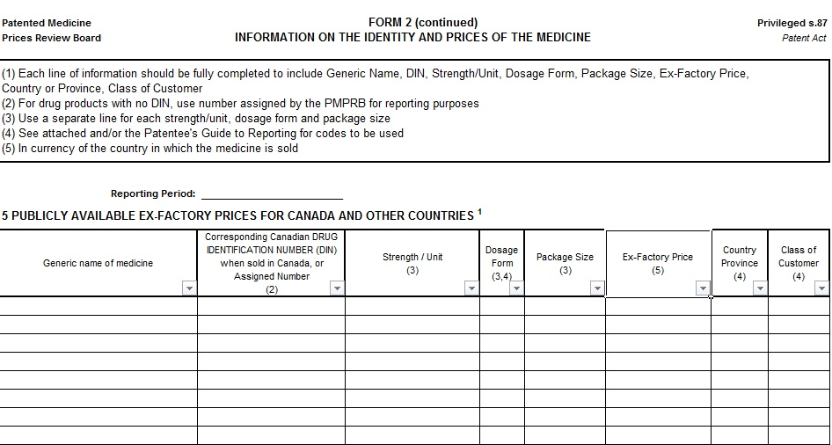
Form 2 – Block 5
Notes:
-Package size can be changed

Slide 20
Reporting Process
Templates for the Form 2 Block 4 and 5 sent by PMPRB to patentee approximately 45 days before reporting deadline
Data submitted by patentee goes through PMPRB electronic verification system – validator.
Error reports are sent back to patentee.
Compliance Status reports sent once company filings have been received for that given period.

Slide 21
Failure to File (FTF)
Patentee is in Failure to File when:
Data is not submitted before the deadline.
Data was not entered in the PMPRB electronic system before the deadline because of errors.

Slide 22
Failure to File (FTF)
All filings need to be sent to compliance@pmprb-cepmb.gc.ca
All filings must be sent in Excel format, if the filings are sent in PDF or any other format, the system will not accept it and it will result in an FTF.
It is a patentee's responsibility to ensure complete information is filed within the statutory time frame. If a company is in FTF, it will be notified, and will be given 7 days to comply. After seven days of non-compliance, a Board Order will be issued.

Slide 23
Most Common Errors - Tips
Don’t forget the cover sheet, i.e. Block 1, 2, 3 and the electronic signature
Block 4 and 5
Strength/Unit, dosage form: Follow the template
DIN, strength/unit, dosage form must be the same on both Blocks
Pack size
Block 5
Generic name: beware of spelling mistakes
Must be publicly available prices
Ex-factory price for Canada must be reported too
Ex-Factory price for other countries must be in national currency of the country

Slide 24
Most Common Errors - Tips
Never comment directly on the Forms: include a separate document (word or e-mail)
Explain in separate document any amendments to Form 2
Must be submitted using the most recent forms available on the website
Filings must be submitted in Excel format
Do not change template

Slide 25
Compliance Status Reports
Sent semi-annually approximately 45 days after the filing deadline.
Excludes new medicines from the current year
Reports on compliance status of existing drug products: Within Guidelines, Subject to Investigation, Under Review, VCU, Notice of Hearing and Does Not Trigger Investigation.
Serves as notification that Board Staff has commenced a new investigation on an existing drug product

Slide 26
Compliance Status Report

Slide 27
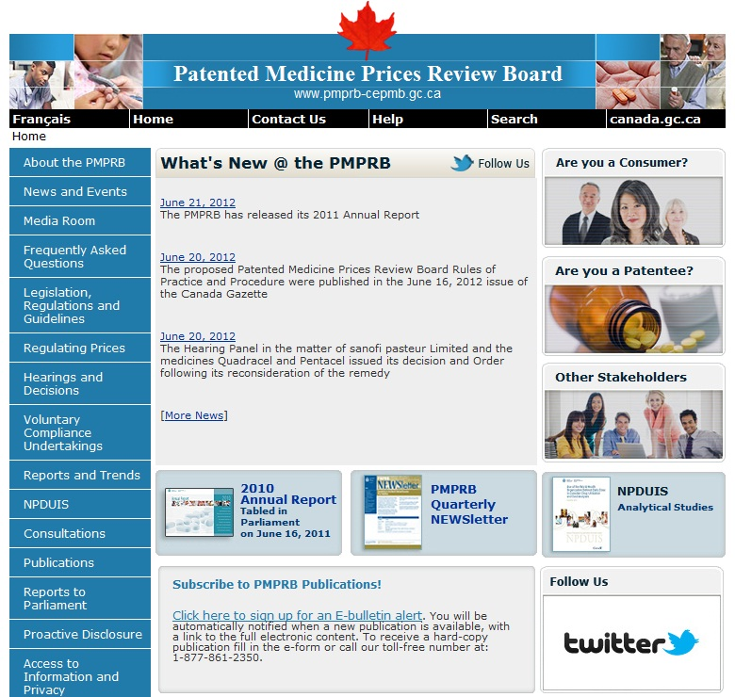
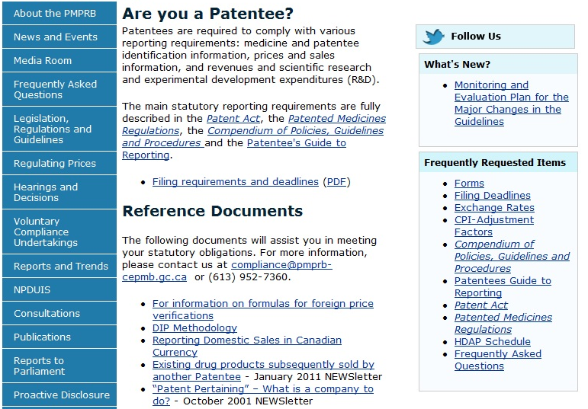
Where to find everything you need…. Website: http://www.pmprb-cepmb.gc.ca/

Slide 28
Where to get help…
Direct questions regarding completion of the reporting forms to the PMPRB by telephone or email.
Christina Conlin
Research/Data Management
christina.conlin@pmprb-cepmb.gc.ca
(613) 948-9219
Beatrice Mullington
Manager, Outreach and Investigation Unit
beatrice.mullington@pmprb-cepmb.gc.ca
(613) 952-2924

