Slide 1
Patented Medicines Prices Review Board (PMPRB): Regulatory Issues and Trends
Michelle Boudreau, Executive Director
4th Annual Market Access Summit
November 21, 2012
Toronto

Slide 2
Outline ________________________________________________
Canadian market and market trends
Role of PMPRB and Overview of Price Regulation Regime
Revised Guidelines - Major Changes
Regulatory Stats & Guidelines Monitoring and Evaluation Plan
Update on Hearings -Anticipated Developments
Looking Forward
Annex
Pharmaceutical Trends Data
Changes and Clarifications to Guidelines Since 2010

Slide 3
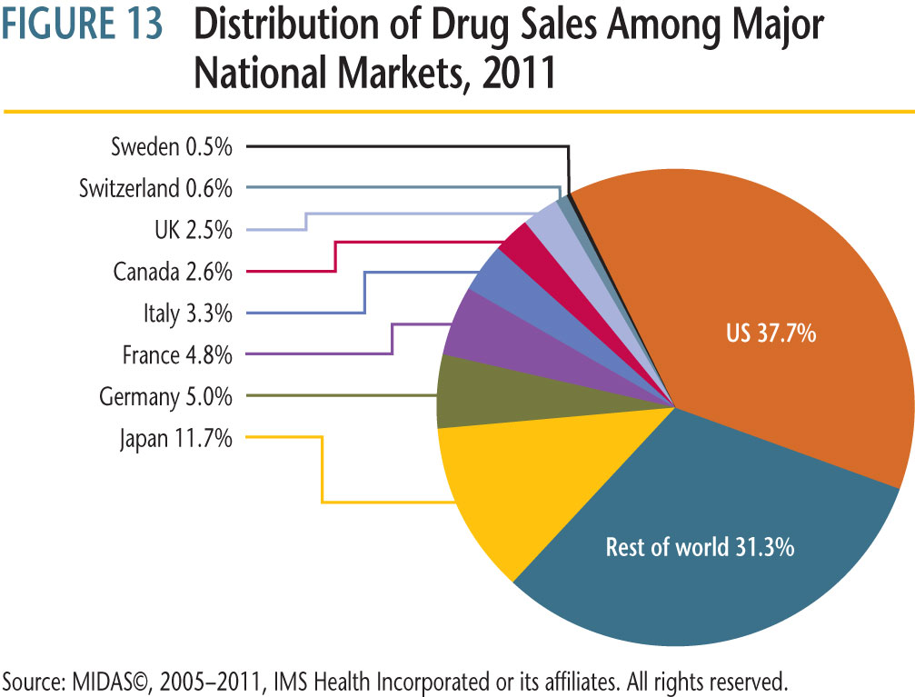
Market trends - Canada Compared to the World ________________________________________________
In 2005 and 2011, Canadian drug sales accounted for 2.4% and 2.6%, respectively, of the global market
Small, but significant market

Slide 4
Market trends - share of total prescriptions* by segment, 2005/06 to 2010/11 ________________________________________________

Slide 5
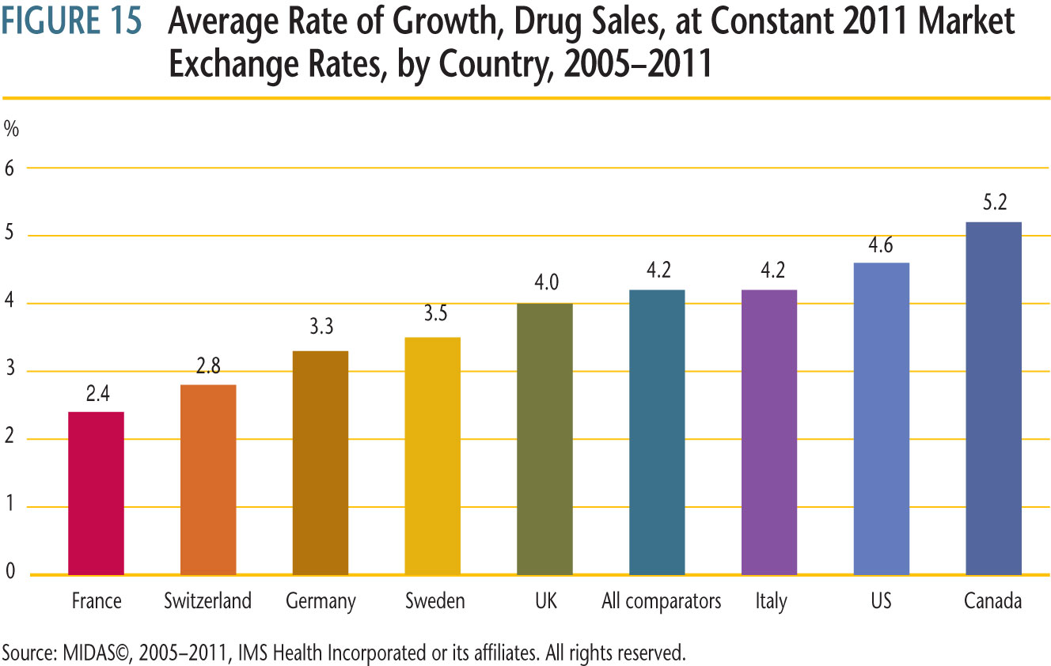
Market trends - Canada Compared to the World ________________________________________________
Growth in drug sales outpacing comparator countries

Slide 6
After introduction, monitor Average Transaction Price (ATP) relative to Non-Excessive Average Price (NEAP), subject to CPI based limit Average Ratio of 2011 Price to Introductory Price, by Year of Introduction

Slide 7
Canada Compared to 21 EU Members - 2010
1.06
Average Price Ratio for 21 EU Members 0.79
Based on top 300 selling oral solids in Canada
IMS Health Data, 2010

Slide 8
Overview of the PMPRB ________________________________________________
Established in 1987 as consumer protection pillar via amendments to Patent Act
The PMPRB is an independent quasi-judicial body with a dual mandate:
Regulatory: To ensure that prices charged by patentees for patented medicines sold in Canada are not excessive
Reporting: To report on pharmaceutical trends of all medicines and on R&D spending by pharmaceutical patentees
Jurisdiction
Regulate prices patentees charge (i.e. factory-gate price) for patented drug products sold in Canada, to wholesalers, hospitals or pharmacies, for human and veterinary use

Slide 9
PMPRB Price Regulation Regime ________________________________________________
Jurisdiction:
Drug products patented and sold in Canada
Instruments:
Patent Act (s. 79–103)
Patented Medicines Regulations
Compendium of Policies, Guidelines and Procedures
Price approval not required before sale
PMPRB establishes a price ceiling, but DOES NOT set selling price of drug product
Regular price reviews to monitor compliance with Guidelines combined with enforcement mechanisms (investigations, Voluntary Compliance Undertakings, hearings, orders)

Slide 10
PMPRB Price Regulation Regime _______________________________________________
Factors to be considered by Board:
Price of medicine sold in Canada
Prices of other medicines in same therapeutic class sold in Canada
Prices of medicines sold in comparator countries
Changes in CPI
Reference based
7 comparator countries: FR, DE, IT, SE, CH, UK, US
Open and transparent price regulation
Hearings are public
VCUs publicly disclosed
MAPP publicly available
* BUT, pricing data filed is confidential (s. 87)
10
Notes:
10

Slide 11
PMPRB Price Tests Blend of Therapeutic Improvement and International Reference Pricing _________________________________________________
Recognize incremental pharmaceutical innovation
At introduction, price premium aligned with degree of therapeutic improvement:
Four new levels of therapeutic improvement:
Breakthrough – Median of International Price Comparison (MIPC)
Substantial Improvement – Higher of top of Therapeutic Class Comparison (TCC) and the MIPC
Moderate Improvement – Higher of mid-point between top of TCC test and the MIP, and top of TCC (primary & secondary factors apply here)
Slight/No Improvement – Top of TCC
Reference pricing at introduction and for existing drugs based on 7 comparator countries - France, Germany, Italy, Sweden, Switzerland, UK, and US
Policy changes in these countries could impact prices in Canada

Slide 12
Investigation Criteria and Outcome ________________________________________________
Investigation into the price of a patented medicine commenced when a complaint is filed or any of the following criteria are met:
New Drug Products
5% above the maximum average potential price (MAPP); or
Cumulative excess revenues are $50,000 or more; or
Existing Drug Products
Cumulative excess revenues are $50,000 or more over the life of the patent
Patentee given opportunity to make further written submissions to Board Staff to substantiate the price
If price within the Guidelines
Investigation closed
If price outside the Guidelines
Patentee given an opportunity to submit a Voluntary Compliance Undertaking (VCU); or
Board Staff refers the matter to the Chairperson

Slide 13
Revised Guidelines - January 2010 ________________________________________________
Guideline Changes | Rationale for Change | Observations
Overall Implementation |  | Ongoing monitoring, evaluation, and resolution of issues Proactive outreach and education
Overall Restructuring of Price Tests | Price premium to reflect therapeutic value | Board Staff proactive in publishing clarification via NEWSletter (see Annex for summary) Board Staff continue to monitor issues
New Levels of Therapeutic Improvement | Recognizing incremental therapeutic innovation | Successfully applied by HDAP members
DIP Methodology | Avoid creating disincentives for offering benefits | Evidence requirements clarified to ensure feasible and easily applied
Any Market | Ensuring that no sub-national market is paying excessive prices | Applies only to drugs sold after January 2010
13
Notes:
13

Slide 14
Guidelines Monitoring and Evaluation Plan (GMEP) -2010 ____________________________________________
GMEP monitors and evaluates the application and impact of major changes to the Guidelines on an ongoing basis
Major Change | Observation
New Level of Therapeutic Improvement | 19% of new drug products classified as “moderate improvement”
Overall Restructuring of Price Tests | 15% of new drug products classified as “moderate improvement” priced at premium (above old Guidelines ceiling)
Any Market | Applied at intro and when investigation triggered <2% overall cases where market specific price higher than national average transaction price
DIP Methodology | Since pilot, 60 DINs successful DIP application: 46 Simple 14 Regular

Slide 15
Regulatory Statistics
 | 2011 | 2010
New Drug Products Introduced | 109 | 68
Number of Investigations | 69 | 87
Of the 109 New Drug Products introduced in 2011:
79% within Guidelines;
9% outside of Guidelines but do not trigger an investigation
12% under investigation
69% were of slight or no improvement; 25% of moderate improvement; 5% of substantial improvement and 1% breakthrough
Between 2000 and 2009, average of 86 new patented drug products/year

Slide 16
Regulatory Statistics: Voluntary Compliance Undertakings and Board Orders – 2008-2012 ________________________________________________
Year | # VCUs | # Board Orders | Payments of Excess Revenues
2008 | 6 | 1 | $25.5M
2009 | 10 | 1 | $37.3M
2010 | 12 | 3 | $13.2M
2011 | 9 | 1 | $0.9M
2012 (September 2012) | 7 | 2 | $14.7M

Slide 17
Update on Hearings ________________________________________________
Matters before the Board
Tactuo – Oct 1, 2012 - Notice of Hearing issued
Ongoing
Apotex Inc. (Failure to File)
Apo-Salvent CFC
Matters before the Federal Court – Judicial Review
ratiopharm Inc.; ratio-Salbutamol HFA; Copaxone Redetermination
Sandoz Inc.
Matter decided by the Supreme Court of Canada in 2011
Celgene Corporation (sale of Thalomid under Special Access Programme)

Slide 18
Anticipated Developments ___________________________________________________________________
Judicial Review | Expected Guidance on..
Copaxone and ratio-Salbutamol | how to weigh ss 85(1) factors the interpretation of the calculation of the ATP pursuant to ss 4(4) of the Patented Medicines Regulations and the obligation of a patentee to file “product specific” information “sufficiency of reasons”
ratio-Salbutamol, ratiopharm and Sandoz | whether the Board can regulate the price of patented medicines sold by generic pharmaceutical companies or has the Board engaged in pure price regulation the scope of “patentee” as per 79(1) of the Patent Act: the Board’s jurisdiction with respect to the first “sale” and the supply chain Interpretation of licencing/supply agreements negotiated at arm’s length whether the corporate relationship between a parent company and its affiliate can allow the Board to conclude that the affiliate is a “patentee” in the absence of a written agreement defining the scope of “patent pertain” as per s 79(1) of the Patent Act

Slide 19
Timing of Judicial Reviews __________________________________________
Copaxone Redetermination
Awaiting Hearing Date most likely in winter
ratio-Salbutamol and ratiopharm to be heard together
Applicant and Respondent Records filed
Request for Hearing Date to be filed
Anticipated that it will be heard in late winter/early spring
Sandoz
Applicant and Respondent to file respective Records
Request for Hearing Date to be filed
Anticipated that it will be heard in late spring/early summer

Slide 20
Looking Forward ________________________________________________
Ongoing engagement and outreach with stakeholders
Continued focus on consumer protection while not creating disincentives to innovation/approaches that benefit consumers/payers
Board adopted two priorities for 2012/13:
alternate dispute resolution (“ADR”) to further enhance compliance
reducing regulatory burden
PMPRB response to recently conducted program evaluation
Continuing engagement with int’l organizations/regulators
Commitment to Guidelines that are responsive to a changing environment

Slide 21
Thank you.
Merci.
michelle.boudreau@pmprb-cepmb.gc.ca
www.pmprb-cepmb.gc.ca
Twitter: @PMPRB_CEPMB
21

Slide 22
Annex - A
Pharmaceutical Trends Data

Slide 23
Market trends - Canadian Public Drug Plan* Spending on Rx Drugs, Rates of Growth and Annual Totals, 2005/06 to 2010/11
* Does not include all drug plans. The totals include drug cost, retail/wholesale mark-ups as well as dispensing fees.

Slide 24
Canada Compared to a Number of OECD Countries 2010
IMS Health Data, 2010

Slide 25
Annex -B
Changes/Clarifications to Guidelines Since 2010

Slide 26
Changes/Clarifications to Guidelines since 2010 ________________________________________________

Slide 27
Changes/Clarifications to Guidelines since 2010 (cont’d) ________________________________________________

